Slide 1
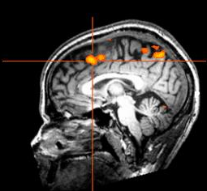
Pattern recognition and multivariate methods for fMRI analysis
Carlton Chu @ Wellcome Trust Centre of Neuroimaging

Slide 2
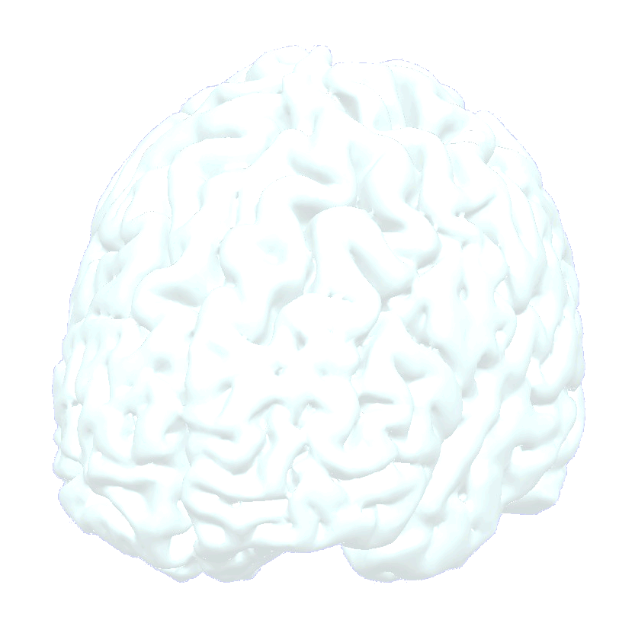
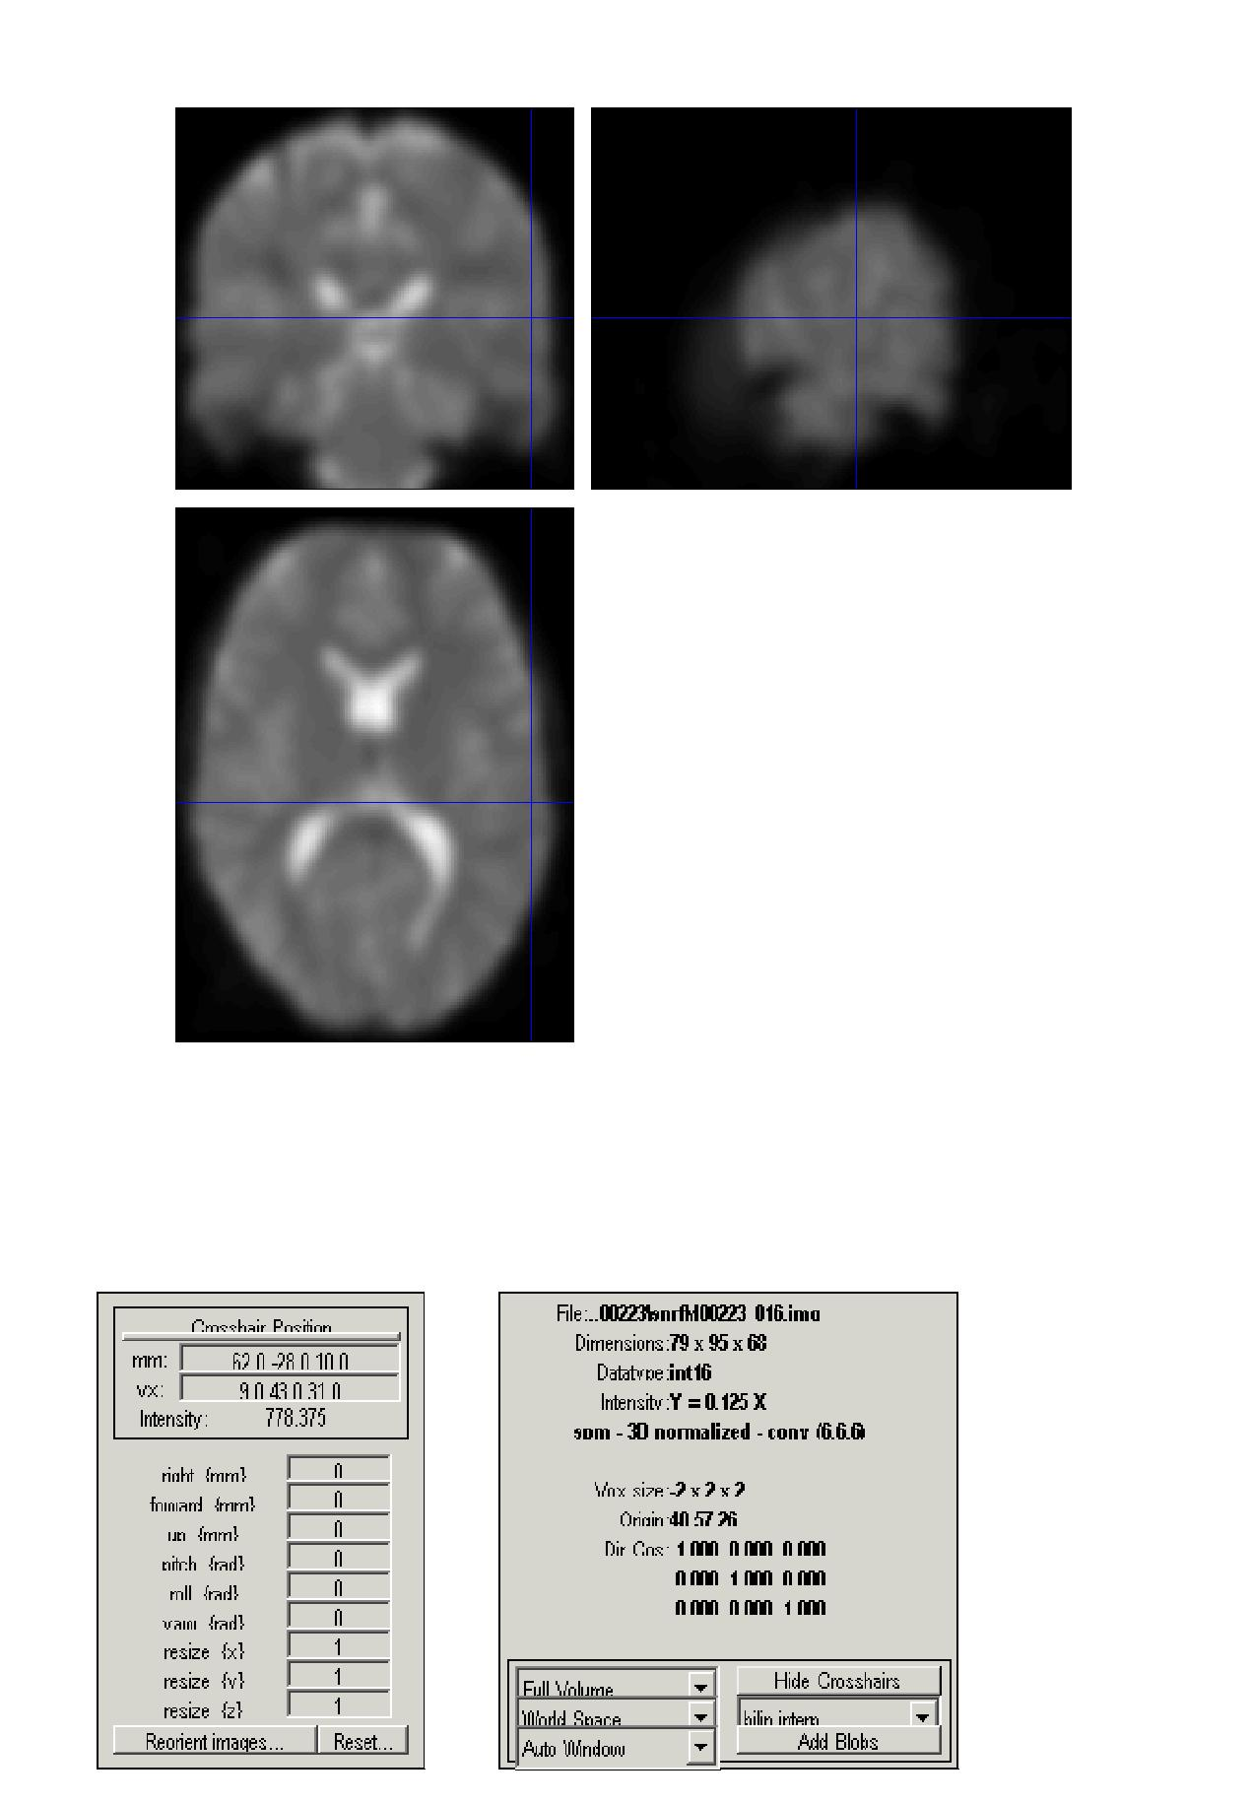
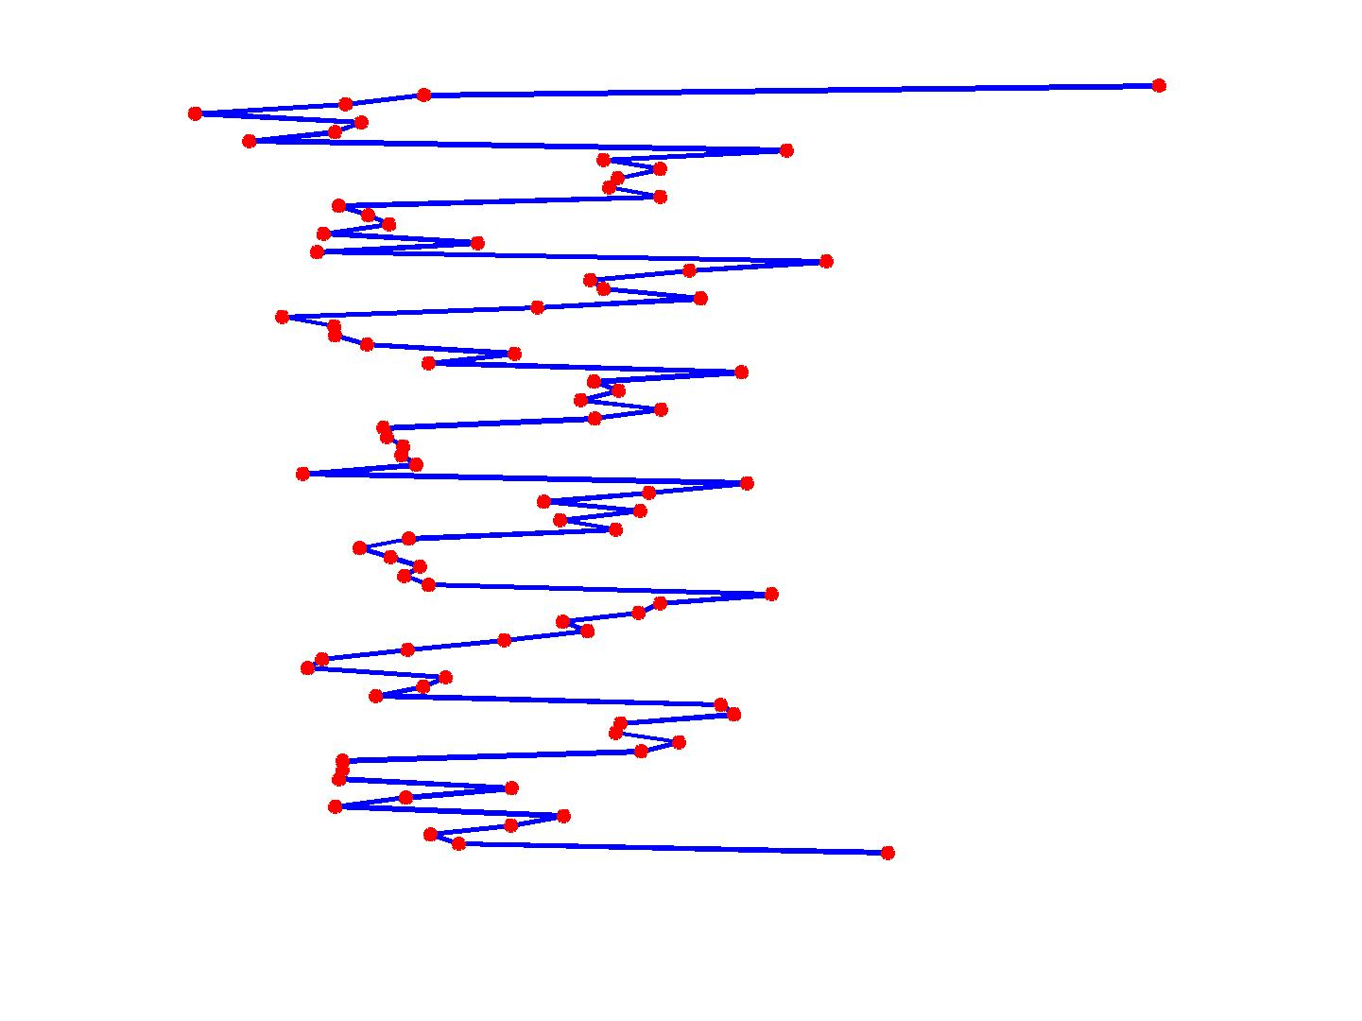
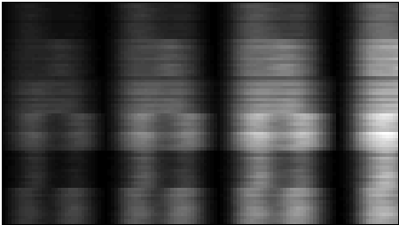
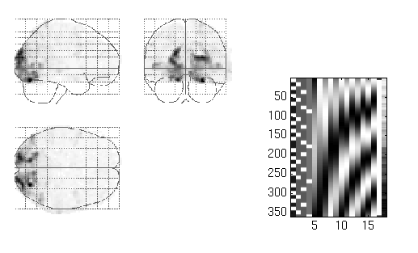
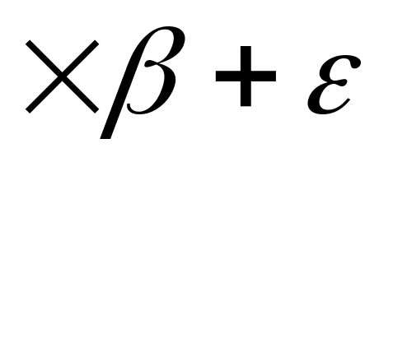
Mass univariate approach
=
Time
Intensity time series of a particular voxel
Y
Design matrix
X
Parameter
beta
Error

Slide 3
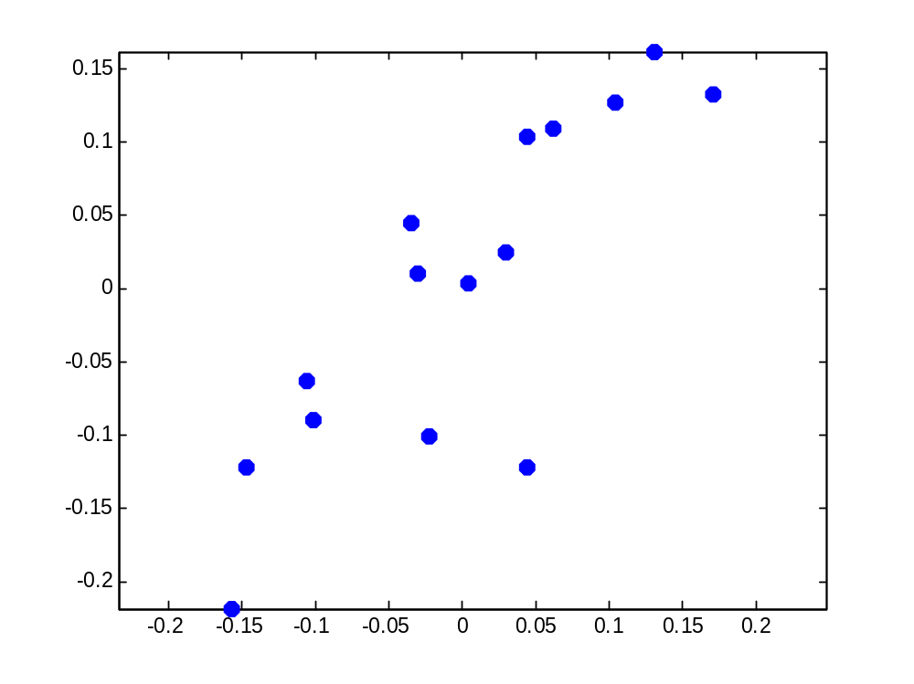
Covariance
Voxel 1 (intensity)
Voxel 2 (intensity)

Slide 4
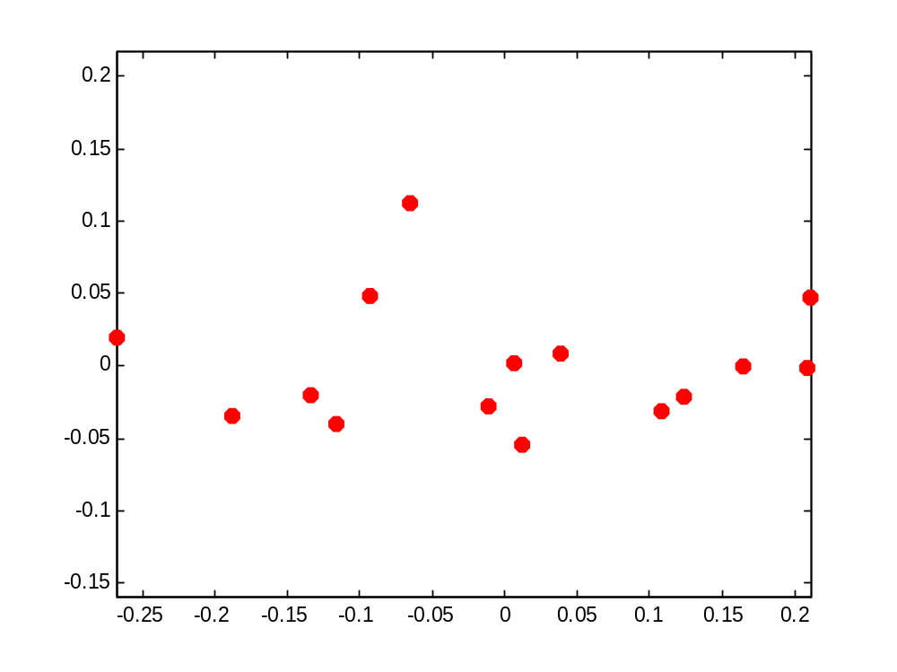
Principle Components
Minor variance
component
Major variance component

Slide 5
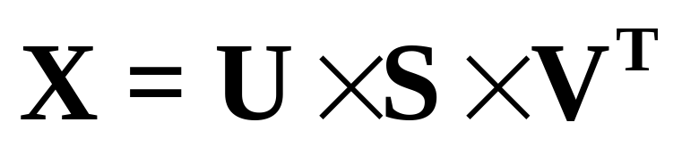
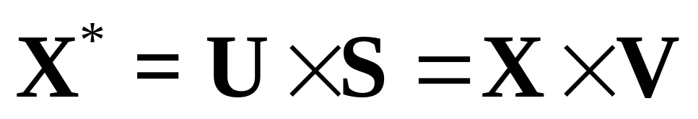

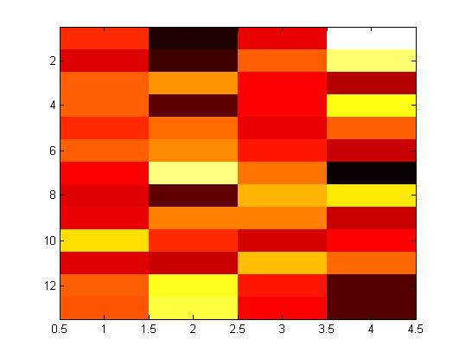
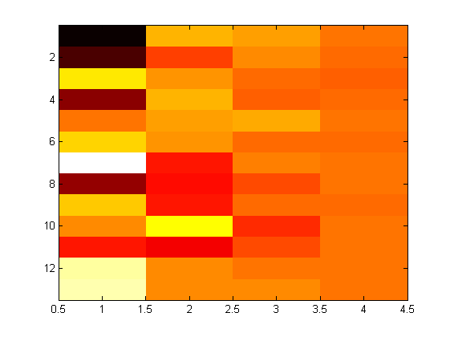
Principle Components Analysis (PCA)
is the new rotated matrix

Slide 6
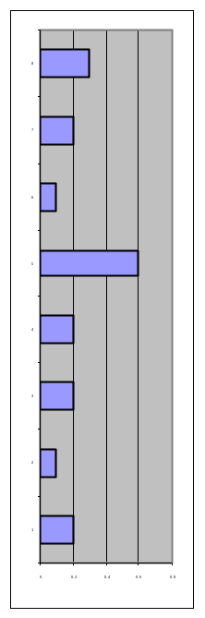
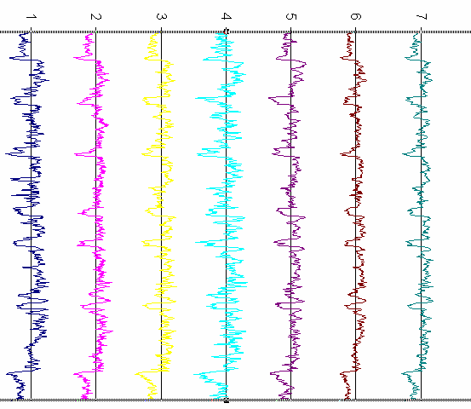
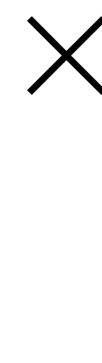
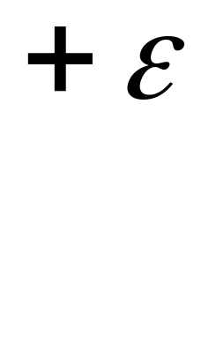

Prediction model (decoding)
Stimuli or
design paradigm
ACTIVITY
Weight (w)
=

Slide 7
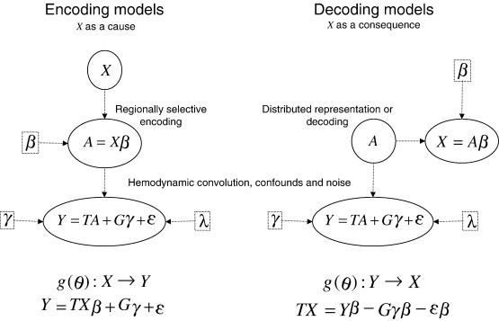
Encoding models vs Decoding models

Slide 8
Learning to Predict
The main achievement of science is predictive accuracy
Theories (models) describe probabilistic relationships among empirically observed data.
Good models predict unobserved data, from other data.
  Interpolative prediction
  Extrapolative prediction
Science advances by replacing old models with those with greater predictive accuracy.
Bayesian model selection indicates predictive accuracy.

Slide 9
Learning the pattern
The goal is to create a mapping y= f(x) between the input features and the targets (classes for classification, values for regression)
Training data {x,y}
Supervised Learning Algorithm
(Optimize function of x
and training error)
Features {x}
Predicted {y}
Traget {y}
Training error
Error function

Slide 10
Training and Classifying
?
Group 2
?
?
?
Group 1

Slide 11
Classifying
?
Group 2
?
?
?
Group 1
y=f(a^{T}x+b)

Slide 12
Linear Discriminant Classifier

Slide 13
Support Vector Classifier
Support
Vector
a is a weighted linear combination of the support vectors
Support
Vector
Support
Vector

Slide 14
Validation
Supervised Learning Algorithm
Training set {x,y}
Training
Collected data {x,y}
Supervised Learning Algorithm
After training
Predicted {y}
{x}
Testing set {x,y}
{y}
Validation Error

Slide 15
n- fold Validation
Data collected {x,y}, divide into n subsets
Use 1 subset for testing
Use n-1 subsets for training
Repeat n times until every subset is used as a testing set
In the case where n= total number of samples, then it is called leave one out cross validation

Slide 16
3 way splits
Data collected {x,y}, split into 3 sets
Use n-2 subsets for training
Use 1 subset for validating the parameters
Leave 1 subset for testing
Split into training, validating and testing set. Use the validation set to adjust the model parameters.
We normally leave one set out, then apply cross-validation on the remaining n-1 set to tune the parameters.

Slide 17
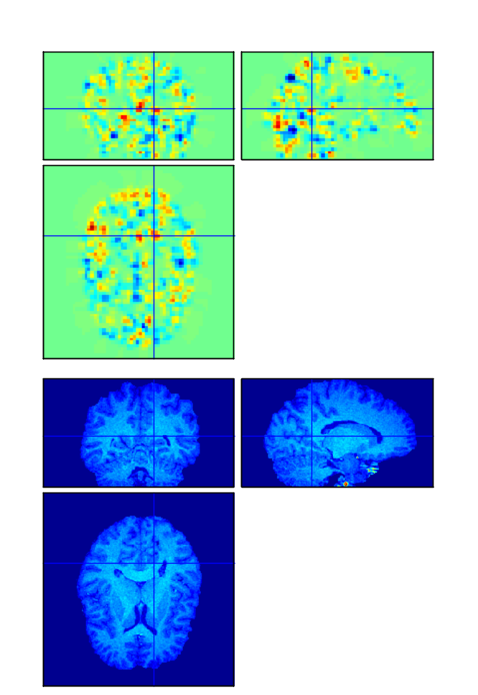
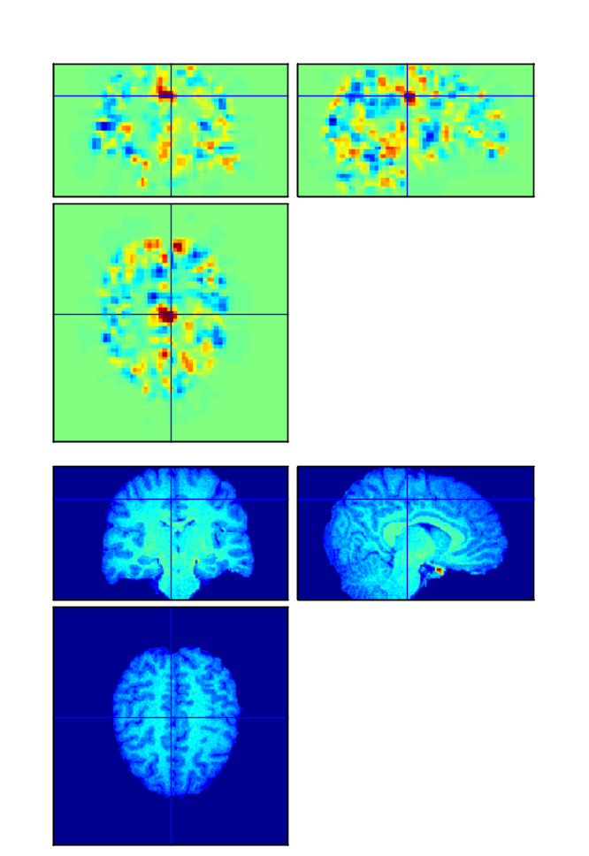
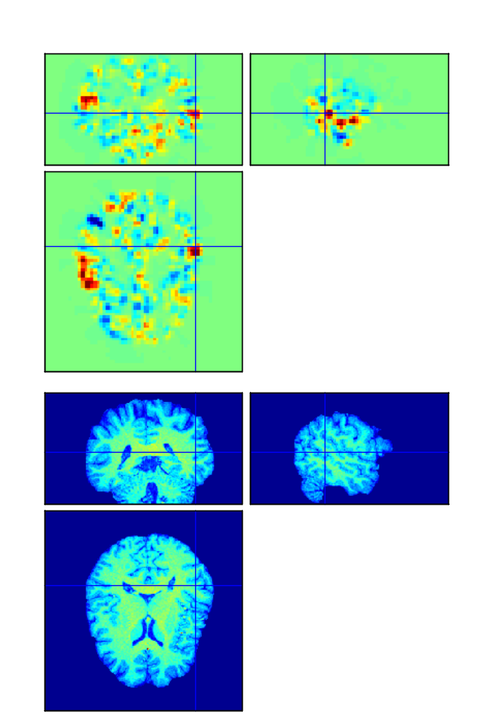
Weight Volume
Subject13 Face
Subject14 Velocity
Subject1 Instruction

Slide 18
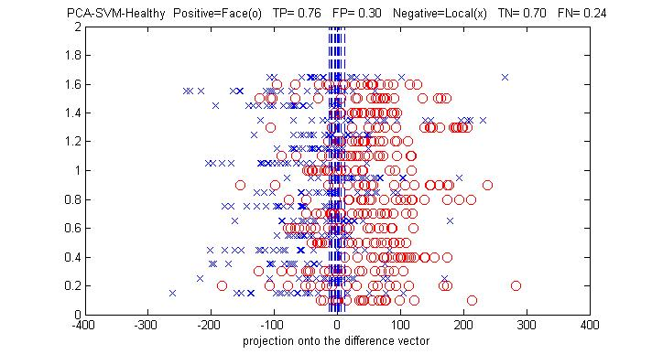
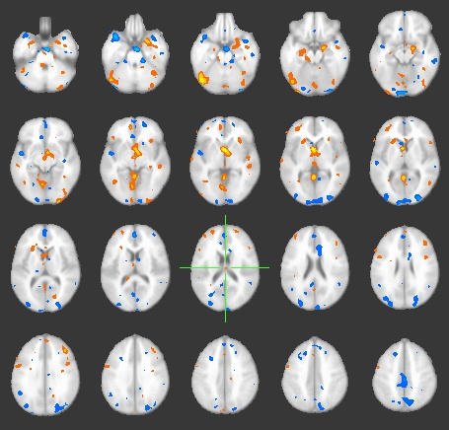
Single volumes classification
Weight vector
Face task x Location task
Location task (x) and Face task (o)
Janaina Mourão-Miranda,

Slide 19
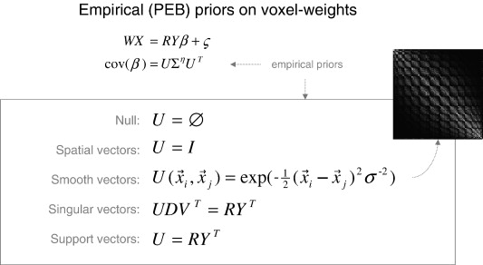
Multivariate Bayes

Slide 20
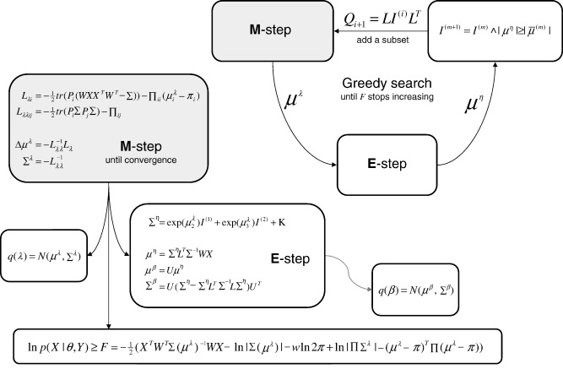
Multivariate Bayes

Slide 21
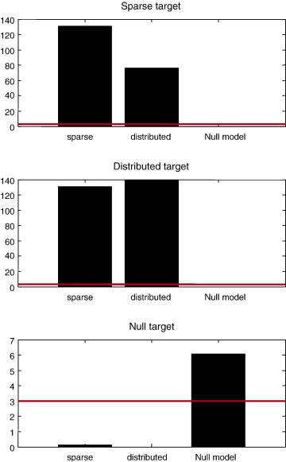
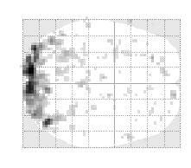
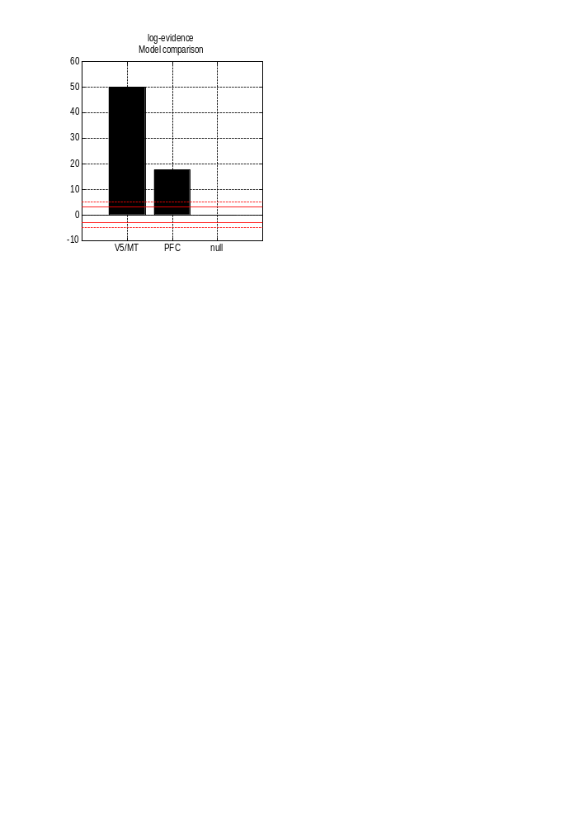
Model Comparison
or

Slide 22
Conclusion
Pattern recognition methods open a new window toward fMRI
analysis
Predictability and the predictive validity give the measure of pattern evidence and generalizability
Bayesian model comparison also arises different measure of pattern evidence
Useful pattern can be utilized such as lie detection or clinical diagnosis

Slide 23
MVB Decoding Practical
Ollie Hulme 02/04/08

Slide 24
MVB Decoding Practical: Contents
Experimental Design: Designing experiments suitable for MVB
Preparation: Prerequisite processing steps for MVB
Guide: Button-by-button step through guide
Ollie Hulme 02/04/08

Slide 25
MVB Decoding Practical: Experimental Design
What types of design allow me to do an MVB analysis?
MVB constitutes a decoding model that uses exactly the same design matrices of experimental variables X and neuronal responses Y as used in conventional analyses.
X-data: Anything you would put in the design matrix.
standard onset regressors (zeroth order) parametric regressors (n-order)
Block vs. event related regressors
Usually these encode the perceptual or behavioural states but can include physiological recordings (GSR, eyemovements etc), diagnostic information (medical, personality) and even activity of other parts of the brain (presumably a prinicipal component from an ROI)
Y-data: Any data you would normally be interested Functional or Structural (e.g. grey matter metrics)
Ollie Hulme 02/04/08

Slide 26
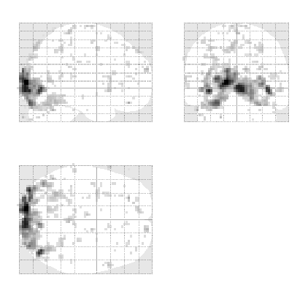

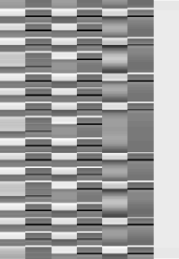
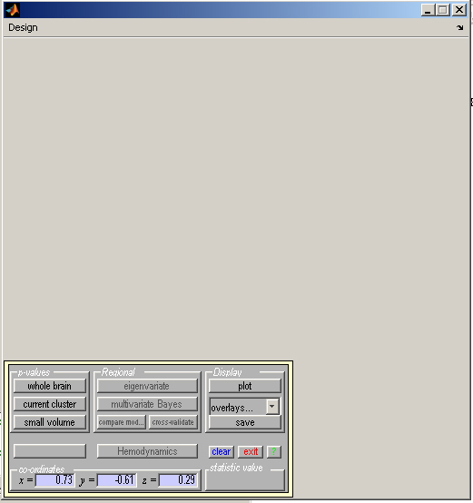
MVB Decoding Practical: Preconditions for MVB
Simply estimate your regression model and calculate a contrast for your target variables.
contrast
Centre the cursor on your ROI
<
<
50
SPM{F
}
100
2,335
150
<
200
250
SPMresults:
300
Height threshold F = 7.052
350
2
4
6
Design matrix
Statistics:
search volume: 16.0mm sphere at [48,-63,0]
set-level
cluster-level
voxel-level
mm mm mm
Note:
Anecdotally for very large design matrices, 1000 volumes x 300 regressors MVB can crash.
p
c
p
corrected
k
E
p
uncorrected
p
FWE-corr
p
FDR-corr
F
(
Z
≡
)
p
uncorrected
0.006
4
39
0.000
0.000
40.66
Inf
0.000
39 -72 0
3
0.000
0.000
40.09
Inf
0.000
42 -75 -3
1
0.002
0.000
13.35
4.55
0.000
39 -63 -12
1
0.124
0.003
8.67
3.52
0.000
51 -66 -3
0.436
0.010
7.36
3.18
0.001
48 -63 0
0
0
Height threshold: F = 7.05, p = 0.001 (0.513) {p<0.001 (unc.)}
table shows 16 local maxima more than 4.0mm apart
0.1
0.2
0.3
0.4
0.5
Degrees of freedom = [2.0, 335.0]
Extent threshold: k = 0 voxels, p = 1.000 (0.513)
0.6
0.7
0.8
0.9
1
Expected voxels per cluster, <k> = 1.212
FWHM = 7.5 7.4 7.1 mm mm mm; 2.5 2.5 2.4 {voxels};
Expected number of clusters, <c> = 0.72
Volume: 15741; 583 voxels; 43.3 resels
Expected false discovery rate, <= 0.01
Voxel size: 3.0 3.0 3.0 mm mm mm; (resel = 14.69 voxels)
Ollie Hulme 02/04/08

Slide 27
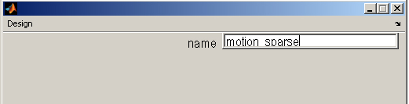
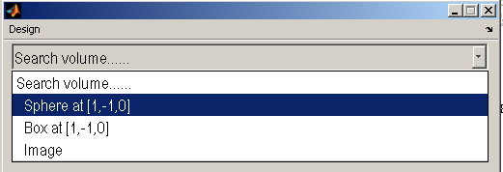
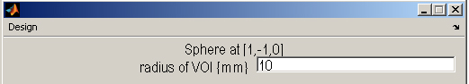
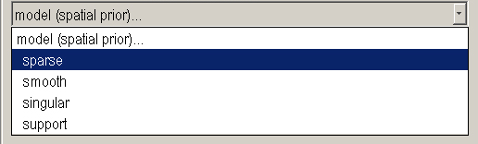
MVB Decoding Practical: Button pressing
Specify search volume according to anatomical hypotheses.
Pragmatically, memory capacity constrains size of search.
Anecdotally: with 2G RAM 20mm radius too large, 10mm fine. (Also likely to vary as a function of the design matrix you are applying it too)
Specify spatial model to compute
Ollie Hulme 02/04/08

Slide 28
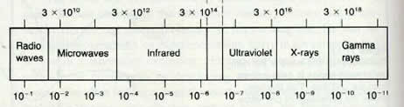
MVB Decoding Practical: Spatial models
MVB is not just for establishing the statistical dependency between the target variable and the neural data. It is designed to compare different models of that mapping. Different models specifying different priors on the mapping.
Key concept is sparsity.
sparse
Grandmother cells
Mass action
distributed
Spatial: models sparse representations over anatomy, analogous to functional segregation. Few voxels have large variance, most have small
Smooth: models sparse representations that are spatially coherent over anatomy
Singular: models distributed representations that are sparse in pattern space, meaning only a small number of distributed patterns expressed at any time
Support: models distributed representations that are not sparse in pattern space, meaning a large number of distributed patterns is expressed.
sparse
distributed
Ollie Hulme 02/04/08

Slide 29
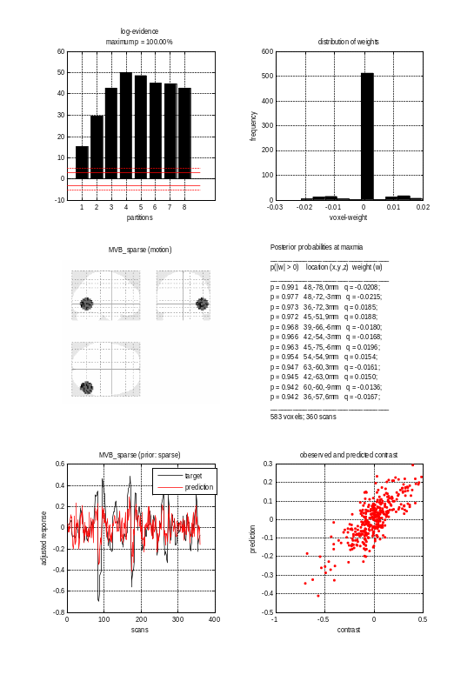
MVB Decoding Practical: Results
distribution of weights
600
500
400
Note sparsity-
few voxels with high weights most with zero weight. Heavy tails indicate anatomical sparsity.
frequency
300
200
100
0
-0.03
-0.02
-0.01
0
0.01
0.02
voxel-weight
Posterior probabilities (that weights are non-zero) of 16 most significant voxels spaced >4mm apart. ROI must be large enough.
Plot of observed and predicted target over scans
posterior probability map showing which voxels contribute to the decoding for the model of interest-
Observed vs predicted. If perfect should be straight diagonal
Ollie Hulme 02/04/08

Slide 30
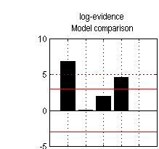
MVB Decoding Practical: Model comparison within area
Repeat for each of the 4 models of interest (saving under different names)
Select all models of interest
A standard threshold is 3 meaning that the model is 20 times (exp(3)) more likely than another- in this case the null model
Bayes factor
spatial
singular
support
smooth
null
Ollie Hulme 02/04/08

Slide 31
MVB Decoding Practical: Model comparison across areas
b
Ollie Hulme 02/04/08

